Slide 1
Intervention Mapping Step 4: Program Production

Slide 2
Intervention Mapping Steps
Logic model of the problem
Program outcomes and objectives (logic model of change)
Program design
Program production
Program implementation plan
Evaluation plan

Slide 3
Step 4: Tasks
Refine program structure and organization
Prepare plans for program materials
Draft messages, materials, and protocols
Pretest, refine, and produce materials

Slide 4
Task 1: Refine Program Structure and Organization
Reality check
Feasibility
Will intended program participants be able to interact with the program?
Will intended implementers have time and resources to implement the program?
Check budget and time constraints

Slide 5
Task 2: Prepare Plans for Program Materials
The first design documents are the matrices
Include creative personnel in team meetings
Prepare design documents specific to each product
Overview
Detailed description of the content – might include storyboards and flow-charts
Messages, themes, motifs, content, sequence
Interactive points and tailoring variables (if appropriate)
Timeline, production qualities

Slide 6
Aiming at Cultural Relevance
Community involvement from the beginning
Cultural concerns affect every part of program planning – deciding on behavioral and environmental change outcomes, “determinants” and change objectives, methods, applications and program materials and delivery
Consideration of deep structure (may influence health behavior) and surface structure (may influence intentional processes (Resnicow et al., 1999)

Slide 7
Examples of Cultural Issues
Deep structure from prostate cancer informed decision-making project: The role of the wife as health care navigator in the African American group but not in the Hispanic group
Both deep structure and surface structure: the role of the church
Surface structure issues such as language, depictions of men
(SIP 21 04, Evelyn Chan PI)

Slide 8
Task 3: Draft Messages, Materials, and Protocols
Consider the change methods and practical applications for a particular set of change objectives
Identify which will “fit” together for presentation in a particular vehicle, e.g., a newspaper story
Draft messages matched to each change objective or combination of change objectives
Draft contextual messages that will be incorporated into the vehicle

Slide 9
Review Available Material
Does the proposed existing material enable the relevant change objectives to be met?
Does it deliver the intended change methods and practical applications?
Does the material represent the correct surface aspects of the culture of the intended audience?
Does the material fit into the planned scope and sequence of the program?
Is the material suitable and available?
It is difficult to make all these matches, but sometimes parts of existing programs work well and will provide a base for development of any materials to address gaps

Slide 10
TLL Temple Foundation Stroke Project: Message development for EDs and primary care providers
Vehicles | Change Objectives Grouped by Determinants | Methods | Message Content
Newspaper article Newsletter | Social norms Recognize other MDs in community respond quickly to stroke; believe other EDs are lowering workup times Outcome expectations Expect patients can recover function with acute treatment of stroke Reinforcement Patient success stories; there may be lack of feedback to ED staff | Modeling through role-model stories Testimonials Vicarious reinforcement | “I had a stroke patient who got to the hospital on time; the ED treated my patient.” “I wasn’t sure about this new treatment, but I’m really pleased with the improvement I saw in my patient.” From patient’s or family’s point of view: I am back to full functioning. The doctor saved our quality of life by acting quickly.”

Slide 11
Production Process - Video
Initial script, storyboard, or layout
Pre-production
Identify role models, actors, locations
First rough cut, or proofs
Review & pre-test
Target audience
Experts
Second rough cut /post production/ proofs
Review, pre-test, revise, final approval

Slide 12
Tasks for Producing a Video
INSERT Figure 7.6 HERE
Figure 7.6

Slide 13
Task 4: Pretest, Refine, and Produce Materials
Pretest for:
Concept
Readability, comprehension, usability
Message
Impact
Cultural sensitivity
Acceptability
Pilot-test for:
Adoption and implementation issues
Logistics
Acceptability

Slide 14
Making Sense of Pretest and Pilot-Test Data
Tabulate data and track recommended changes
Develop a plan for dealing with conflicting opinions and results
If something is changed, make sure the change does not disrupt or eliminate an important element or change method
If activities or change methods are deleted, attempt to replace them with equally powerful methods and messages

Slide 15
Example
It’s Your Game…Keep It Real (IYG)
A sexual health education program for middle school students

Slide 16
Task 1: Refine Program Structure and Organization
Feedback from school district and school-level administrators and health education teacher to indicated that the IYG scope and sequence was feasible but would require advanced planning
Teachers would need to modify lesson plans in advance
Administrators would need to coordinate with IT specialists or school librarian to ensure computer access

Slide 17
Task 2: Prepare Plans for Program Materials
Program planners produced design documents for:
15 x 50-minute classroom lessons
9 computer lessons
Interactive skills-training exercises
Peer role model videos
“Real world”-style teen serials (Reel World)
Some activities were tailored by gender and sexual experience
Design documents included:
Targeted change objectives, methods and applications
Estimated duration
A detailed description of characters and setting
Discussion prompts
Itemized scripts for Reel World serials

Slide 18
Example Design Document
INSERT Figure 7.9 HERE
Figure 7.9

Slide 19
Task 3: Draft Messages, Materials, and Protocols
Program planners:
Wrote content (messages) for all activities
Ensured that the parameters of use of specific methods were met
Hired creative consultants (videographers, post-production video editors, and computer program developers) to produce video- and computer-based activities
Drafted curriculum manual for teachers
Itemized timing, materials required, and activities for each lesson
Drafted parent newsletters

Slide 20
Classroom Role-Play: The Football Game
Directions: Using clear NO statements and/or alternative actions, complete the “You” lines.
Setting the Stage: You are hanging out with your partner at a football game when it starts to rain. Your partner suggests you go hang out in the car, which you do. The two of you start to kiss but then your partner goes too far- they do something that challenges your rules. You start to pull away.
Your partner: Hey, what are you doing? I thought we were having a good time.
You: _________________________
Your partner: Come on, I thought you really liked me.
You:_________________________
Your partner: Don’t be so lame, we’ve been seeing each for a few weeks now.
You:_________________________
Your partner: If you don’t want to do this, I’ll go find someone who will.
You:_________________________
Reprinted with permission of The University of Texas Health Science Center at Houston, copyright 2000–2014

Slide 21
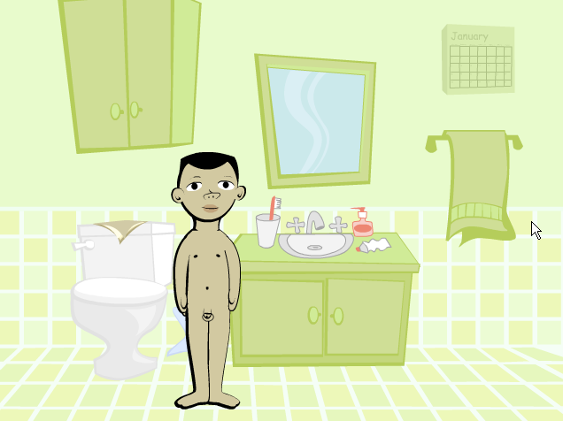
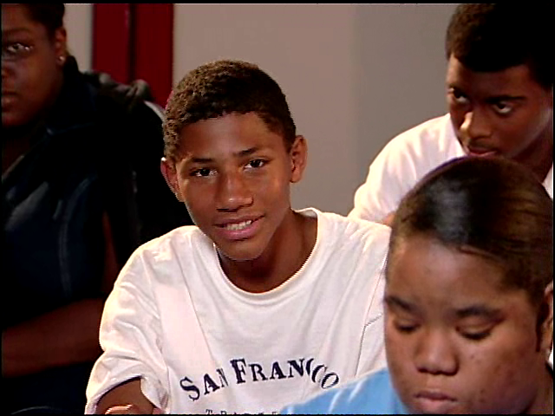
Example Computer Activities
Information transfer
Refusal Skills Training
Peer modeling
Condom Skills Training
Reprinted with permission of The University of Texas Health Science Center at Houston, copyright 2000–2014
Notes:
21

Slide 22
Sample Pages from Parent Newsletter
INSERT Figure 7.11 HERE
Figure 7.11

Slide 23
Task 4: Pretest, Refine, and Produce Materials
Teen Advisory Board members pretested video scripts, role-plays, and other interactive student activities
Project staff pilot-tested classroom lessons in middle schools
Fourteen 7th & 8th graders beta-tested computer lessons
Usability surveys
Pre- and post-lesson ratings
Importance of content domains
Self-efficacy to perform targeted behaviors (refuse sex, use a condom)

Slide 24
Pretest and Pilot-Testing Results
Students reacted favorably to classroom activities and provided feedback to improve directions and specific activity content
Some lessons ran longer than 50 minutes indicating the need to delete or abbreviate activities
Computer beta-testing results were favorable
Posttest ratings of importance of program content & self-efficacy to perform behaviors increased across all domains (p < .05)
78-100% rated activities easy to use
93% rated content correct and trustworthy
100% agreed most words were understandable
71-100% rated specific activities as fun
93-100% rated IYG as helping them make healthy decisions on sexuality

Slide 25
Summary
IM Step 4 comprises 4 key tasks:
Refine program structure and organization
Prepare plans for program materials
Draft messages, materials, and protocols
Pretest, refine, and produce materials

Slide 26
Questions?

